Slide 1
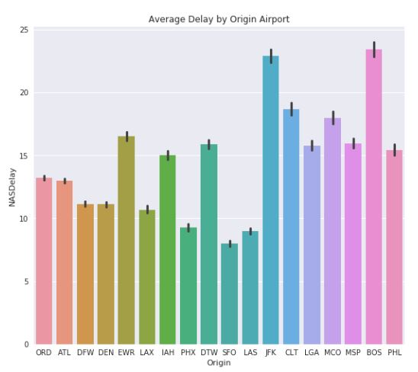
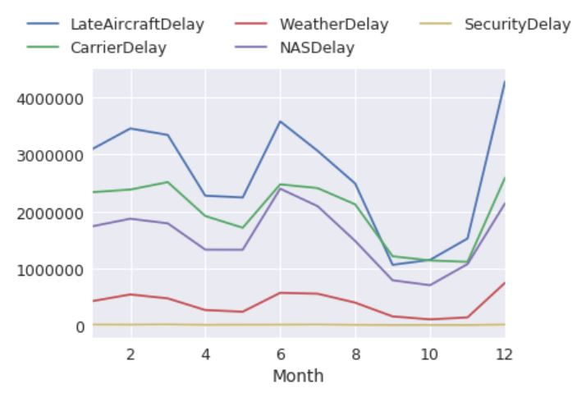
U.S. Airline Operation Recommendation
The economic price of domestic flight delays is costly for both airlines and passengers, main reasons behind delays were analyzed based on 2008 delayed flights data from U.S. Department of Transportation’s (DOT) Bureau of Transportation Statistics (BTS).
NAS Delay* is more common in less busy airports, and airlines with lower volume of flights tend to have a higher chance of Carrier Delay.
Delays are concentrated in February, June, and December, with a peak on average number of delayed flights in July 2008.
One solution to NAS Delay lies within air carriers. If the airline crew can avoid intentionally slow down flights to save fuel, then the number of flights delayed would potentially decrease, along with a reduction in NAS and Late Aircraft Delay incidents.
*NAS Delay: Delay that is within the control of the National Airspace System (NAS) may include: non-extreme weather conditions, airport operations, heavy traffic volume, air traffic control, etc.

